Slide 1
Modeling & Understanding Relationships
By Nungo Tshidzumba

Slide 2
Agenda
Covariance Analysis
Scatter Plot Visualisation
Model Evaluation: Cross Validation
Business Case: Delta Airlines- Data Analytics and Strategy
Strategic Insights for Delta Airlines
What Should Delta Airlines Do Next?

Slide 3

Covariance Analysis
INTERPRETATION
● Account Age and Add-On Spend have a negative covariance (-1975.332202), which suggests that as Account Age increases, Add-On Spend tends to decrease slightly. This may indicate that customers who have been with Delta Airlines for a longer time might be spending less on add-ons, which could point to declining engagement or loyalty.
● The magnitude of covariance tells us about the strength of the relationship, though the negative sign is the most important here in terms of the direction of the relationship. However, the covariance alone isn't enough to conclude if this relationship is strong or meaningful, as it depends on the scale of the variables.

Slide 4
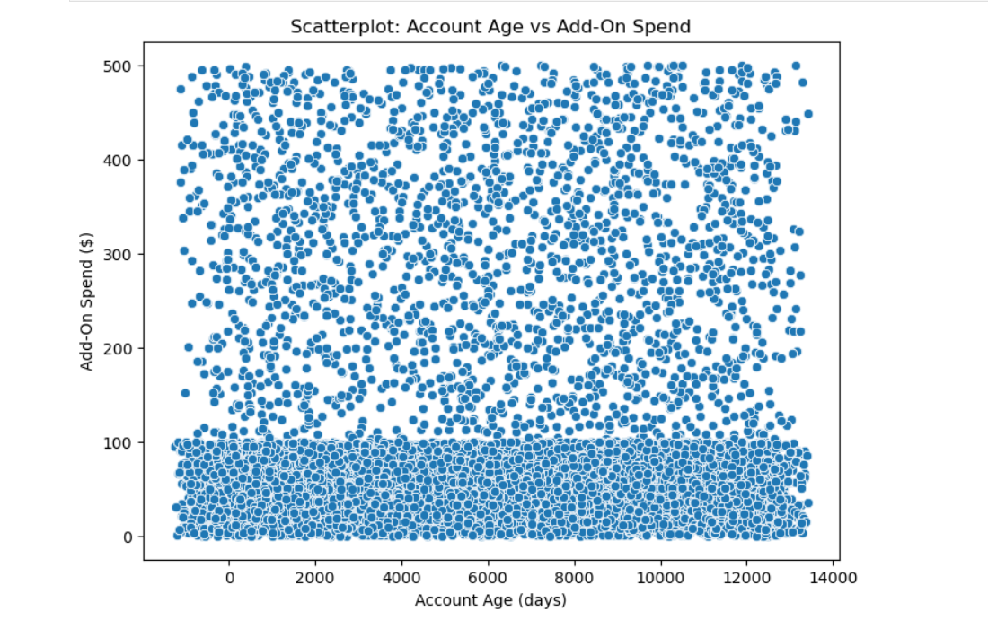
2. Scatterplot Visualisation

Slide 5
Interpretation
This suggests a non-linear or weak relationship between Account Age and Add-On Spend.
There is a significant amount of overlap or clustering of data at the lower end (perhaps indicating that a lot of customers are in the early stages of their relationship with Delta).
Scattered points further up indicate that, while there might be some variance, it is difficult to see a clear linear trend between these two variables.
What does this tell us?
Since the scatterplot doesn't show a clear upward or downward trend, the relationship between the two variables might not be strongly linear, reinforcing the negative covariance but indicating that this relationship may not be easily modeled or leveraged.
Delta Airlines may need to focus on customer behavior at various stages of their journey (early vs. long-term customers) to better understand why Add-On Spend decreases with Account Age

Slide 6

3. Model Evaluation: Cross-Validation
INTERPRETATION
● An average cross-validation score of 1.0 means that the model perfectly fits the training data across all folds during cross-validation. This could indicate that the model is overfitting, which means it performs excellently on the training data but may not generalize well to unseen data.
● Overfitting risk is high here, especially since the performance on the training data is perfect. This suggests that the model might have learned the noise or very specific patterns in the training set that don't represent the general data distribution.
What to do next?
● Since the model shows perfect performance on training data, we should test it on a separate validation or test set to ensure
that it generalizes well and doesn't just memorize the data. Alternatively, using regularization techniques (like L1 or L2 regularization) can help prevent overfitting

Slide 7
4. Business Case: Delta Airlines- Data Analytics and Strategy
Scenario Context:
Delta Airlines is struggling with:
Increasing competition from low-cost carriers.
Siloed data that’s hard to analyze effectively.
Heightened regulatory pressure.
Complex data security and management needs due to the 2024 Crowdstrike Incidents. Delta’s goal is to assimilate their data and leverage AI and CRM solutions to develop a robust 5-year business strategy. The airline needs to focus on customer loyalty, engagement, and retention to maintain a competitive edge

Slide 8
5. Strategic Insights for Delta Airlines
How does the covariance, scatterplot, and model evaluation tie into this business case?
Covariance: The negative covariance between Account Age and Add-On Spend indicates that customers who have been with Delta for a longer time might be spending less on additional services. This could suggest a decline in customer engagement or interest over time, which is critical information for Delta Airlines. If long-term customers are spending less on add-ons, Delta might need to reevaluate its customer loyalty and engagement strategies for these customers.
Scatterplot and Trends: The scatterplot’s scattered nature and clumping at the bottom suggest early-stage customers have less variation in their spending, whereas long-term customers are more varied. This could help Delta identify customer segments: new customers might be more price-sensitive, while long-term customers may have habits or preferences that are more predictable but in need of engagement programs.
Model Evaluation (Overfitting): Overfitting indicates that the model might be too tailored to the specific dataset, without considering broader trends that could be more applicable to unseen data. For Delta, this could mean that they need a model that accounts for different stages of customer engagement, avoiding overly complex models that do not generalize well. Regularization, more varied data, or focusing on simpler models could be beneficial for Delta’s customer segmentation and engagement strategies

Slide 9
6. What Should Delta Airlines Do Next?
Customer Segmentation: Delta should segment customers based on account age and spending patterns. Customers who have been with Delta for a longer time but spend less on add-ons could be targeted with personalized offers or loyalty programs to increase their engagement and spending.
Predictive Modeling: Based on the covariance and scatterplot results, Delta could use predictive models that help anticipate which customers are at risk of attrition (long-term but disengaged customers) and focus retention efforts on these customers. Regularization methods should be used to avoid overfitting.
Data Strategy: Delta should integrate siloed data sources and create a unified CRM system that captures customer behaviors at various points in their journey. This will allow for more accurate predictions, enhanced engagement strategies, and a tailored business plan for customer retention and loyalty.
Five-Year Strategy: The business strategy should incorporate AI-driven insights about customer behavior, focusing on personalized experiences that can drive greater add-on spending and customer satisfaction over time.

